Slide 1
Graphs
How to translate equations into graphs and vice versa
Make sure you read the notes
Notes:
The idea of this presentation is to make you look at different aspects of graphs. If it does that… it has succeeded.

Slide 2
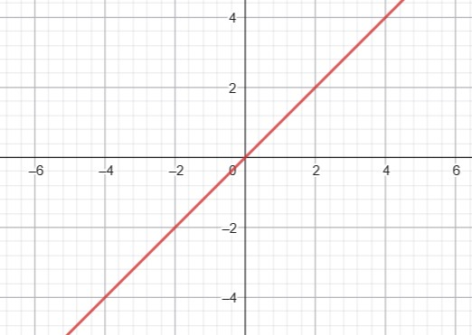
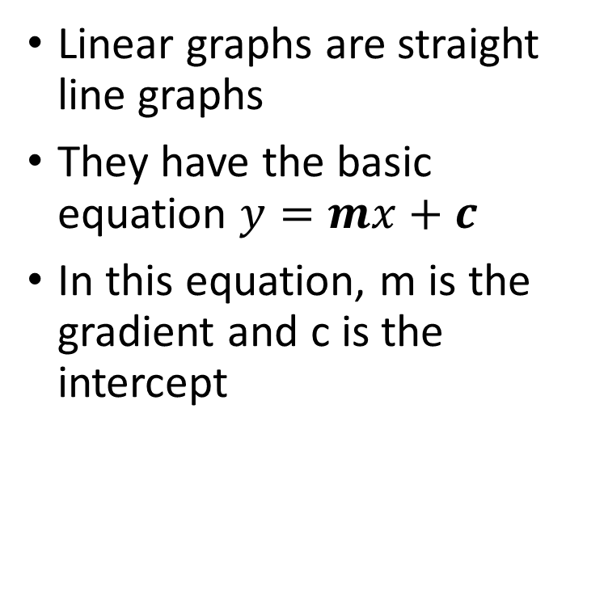
Linear Graphs
Linear graphs are straight line graphs
They have the basic equation $y=mx+c$
In this equation, m is the gradient and c is the intercept
Notes:
The first type of graph to which we are to be introduced is the linear graph. These are called linear graphs because if you join all the points together, they form a straight line.
Linear graphs have the basic function y=mx+c although this can look different depending on how the question is presented. The rule of thumb is that the equation can be rearranged to make it in the form of y=mx+c.
This equation will tell us what any value for y is when we plug in the value for x.
So the x and the y are co-ordinates along the line depending on the equation. The question is, for what do the m and the c stand?
M is the gradient of the slope. No one seems to know for definite why the letter m is used but two common thoughts are that it comes from the French word for to climb, “Monter” or John Conway has suggested it could stand for the modulus of the slope. No one seems to know and it is quite possible that it was just a random letter that someone picked and it has stuck. Whichever is the truth about its historical origin, the slope or gradient is how steep something is. If it is the equation was y=2x+3, the slope would be steeper than 45° but not as steep as if the equation was y=5x+3.
In the equation above, the c represents the constant value of y when x is zero. We call this value the intercept and it is the point at which the graph crosses the y axis. It often represents a significant part in any problem, for instance, in a graph of water usage vs cost, the y-intercept will represent the standing charge on a bill which is what you pay just to be connected to the service before you have used any water at all.

Slide 3
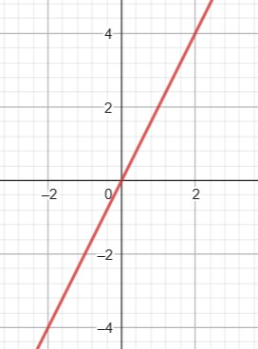
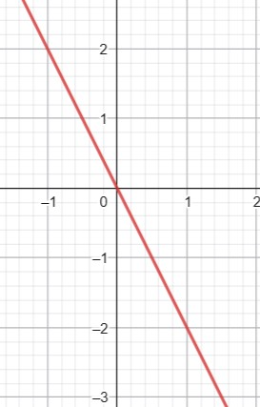
Positive and Negative X Coefficients
Positive x coefficients mean the gradient is positive and the slope goes from bottom left to top right on the graph
Negative x coefficients mean the gradient is negative and the slope goes from top left to bottom right on the graph
Notes:
So, we have got the idea of a straight line graph and the equation of y=mx + c.
Now, we are going to look at the idea of the negative and positive coefficients of x.
Firstly, we need to deal with the idea of a coefficient. What is it and what does it do?
Well the x coefficient is the number glued to the front of x when we are using algebra. Generally, it is the number by which we multiply x. So if y=2x, that means when x is 3, y is 2 times 3 which is 6. When x is 4, y is 2 times 4 which is 8.
Now in graphs, the x coefficient is the gradient. The higher the absolute value of the number, the steeper the graph, so y=7x is steeper than y=3x.
At the same time, y=-7x is steeper than y=-3x. So what is the difference between positive gradients and negative gradients?
Well the difference is, quite simply, the direction that the graph runs. Moving from left to right on a graph, if the x coefficient (or gradient, m) is negative then the graph goes downhill. If the x coefficient is positive, then the graph goes up hill.

Slide 4
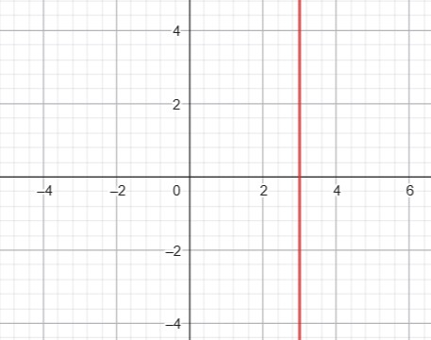
Vertical Lines: x = a
If you plot points on a graph immediately above each other, the x-coordinate of each point is the same.
We can describe all the points as having an x value equal to a.
The equation of the line connecting all these points is x=a
Strangely, this means that the equation of the y axis is x=0
Notes:
If you plot the points (2,-3), (2,-2), (2,-1), (2,0), (2,1), (2,2) , (2,3) etcetera, the equation that describes this line is x=2 as that is the thing that all these points have in common. The y co-ordinate changes as you move up and down the graph so we can’t describe the whole line using the y co-ordinates.
So a graph with the general equation, x=a is a vertical line.
Obviously, the y axis is a vertical line where the x co-ordinate for all the points on the line is 0, so we can call the y-axis x=0. You need to think about this point carefully as people easily mix up the equations and just say that because the y axis is vertical, y=0 but this is incorrect.

Slide 5
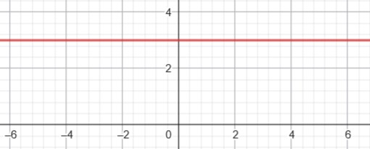
Horizontal lines: y = a
If you plot points on a graph immediately alongside each other, the y-coordinate of each point is the same.
We can describe all the points as having an y value equal to a.
The equation of the line connecting all these points is y=a
Like the y axis was x=0, this means that the equation of the x axis is y=0
Notes:
If you plot the points (-3,5), (-2,5), (-1,5), (0,5), (1,5), (2,5) , (3,5), this time the equation that describes this line is y=5 as that is the thing that all these points have in common. The x co-ordinate changes as you move from left to right along the graph so we can’t describe the whole line using the x co-ordinates.
So a graph with the general equation, y=a is a horizontal line.
The x axis is a horizontal line where the y co-ordinate for all the points on the line is 0, so we can call the x-axis y=0.
Try to remember that if you look at the x axis, the numbers are changing all the way along the line but the level of the line remains constant so the equation of the x axis is y=0.

Slide 6
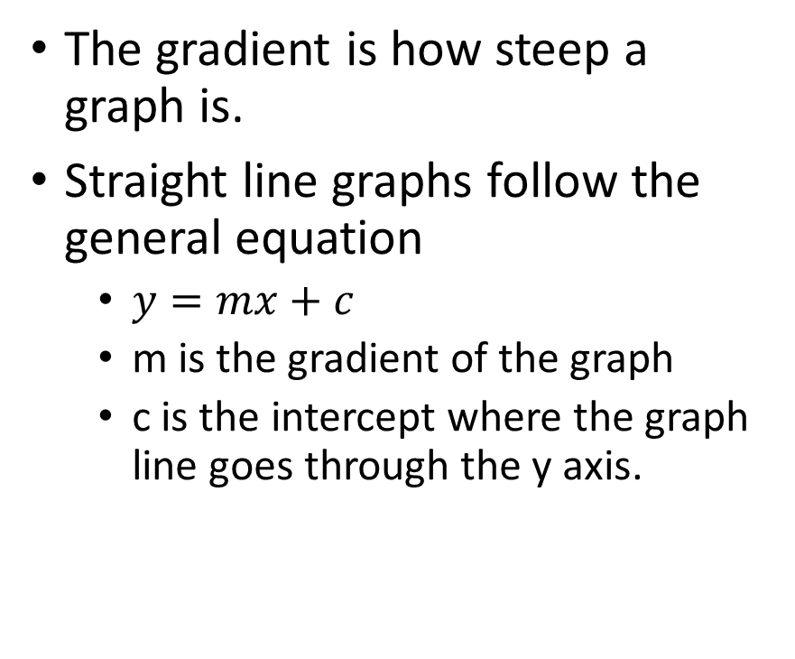
The Gradient of a Straight-line Graph
The gradient is how steep a graph is.
Straight line graphs follow the general equation
$y=mx+c$
m is the gradient of the graph
c is the intercept where the graph line goes through the y axis.
Notes:
The gradient of a straight line graph is how steep the line is. On the equation, y= mx+c, the m is the gradient and this is the number which determines how steep the graph line is. The higher the value of m, the steeper the line.
We can work out the gradient of a graph by finding the co-ordinates of two points on the line. If we determine which point is the left most (by comparing the x co-ordinates), we can name that point 1 and then just do the y co-ordinates y2 minus y1 and then divide that by the x-co-ordinates x2-x1.
This will give us the gradient.
In the cases we have looked at so far, the graphs, y=a, for instance, would have a gradient of zero as the line is flat and goes neither up nor down.
In the case, x=a, the graph has no run and so cannot be written in the form of a gradient particularly as you are not allowed to divide by zero. It would, in effect, have an infinite gradient.

Slide 7
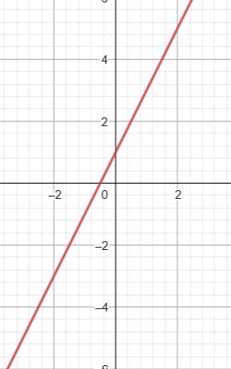
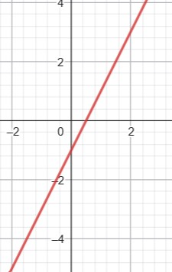
The Intercept in Polynomial Equations
Almost all polynomial graphs have an intercept – not just those with straight lines.
The intercept is the “+3” or the “-5” at the end of most equations.
If a graph doesn’t have a plus five or minus three, the intercept is usually the origin.
Notes:
The intercept is given the letter c in the equation y=mx+c.
The intercept is where the graph line crosses the y axis.
Positive values for the intercept means that the graph is transposed upwards. Negative values mean it is transposed downwards.

Slide 8
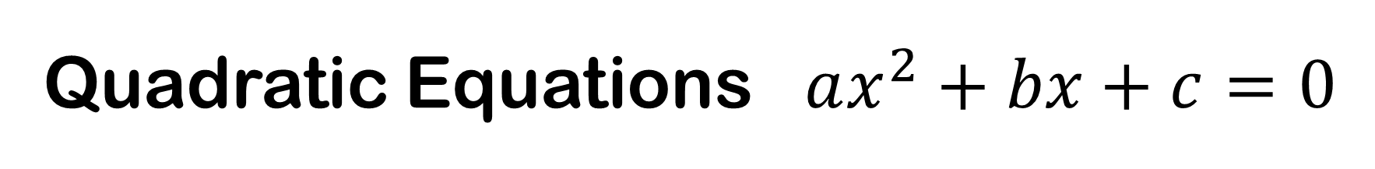
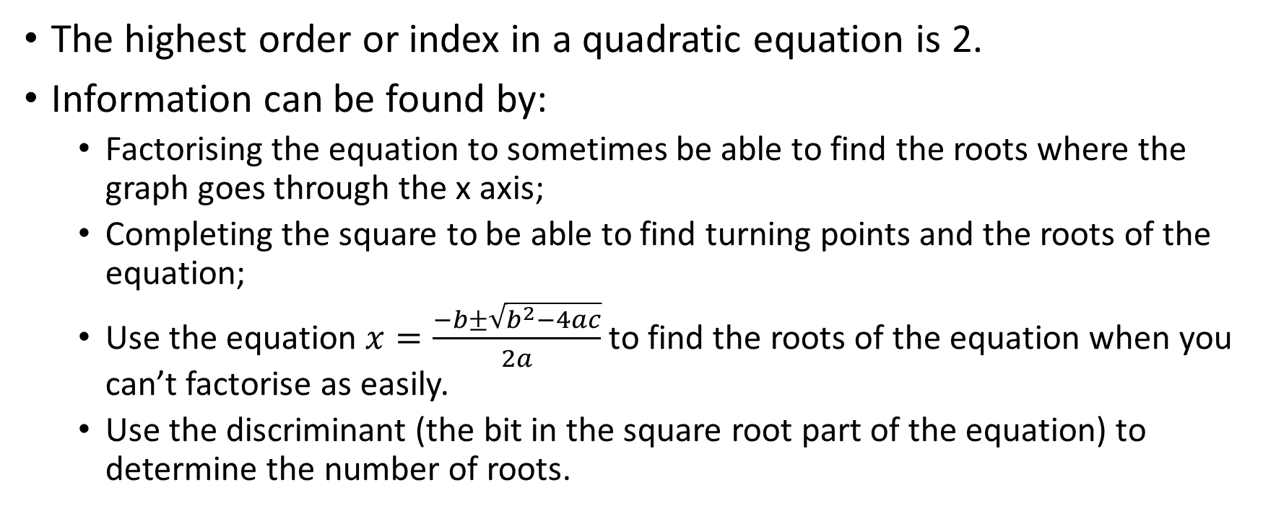
Quadratic Equations $ax^{2}+bx+c=0$
The highest order or index in a quadratic equation is 2.
Information can be found by:
Factorising the equation to sometimes be able to find the roots where the graph goes through the x axis;
Completing the square to be able to find turning points and the roots of the equation;
Use the equation $x=\frac{−b±\sqrt{b^{2}−4ac}}{2a}$ to find the roots of the equation when you can’t factorise as easily.
Use the discriminant (the bit in the square root part of the equation) to determine the number of roots.
Notes:
Quadratic equations have an order of 2 which means that the highest index that is available in the equation is a 2.
There are several parts to a quadratic equation which interest mathematicians. The first of the these are the roots of the equation. This is where the graph passes through the x axis. These can be calculated by completing the square, factorising or using the quadratic equation.
The other main points of interest would be the equation of the line of symmetry which would be x equals… and finally, the co-ordinates of the turning point or stationary point.

Slide 9
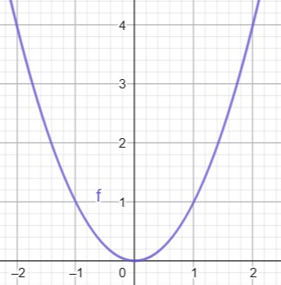
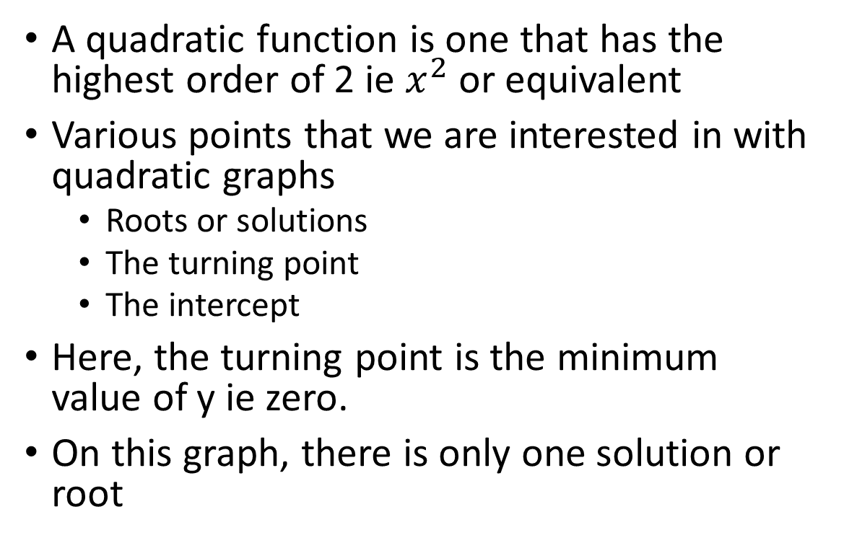
Quadratic Graphs
A quadratic function is one that has the highest order of 2 ie $x^{2}$ or equivalent
Various points that we are interested in with quadratic graphs
Roots or solutions
The turning point
The intercept
Here, the turning point is the minimum value of y ie zero.
On this graph, there is only one solution or root
Notes:
Quadratic graphs have a term with the highest order of 2, ie something squared. It might just be x squared or 5x squared but it cannot have any index in the equation that is greater than 2. However, it must have a term that is an x squared or something squared term.
The shape of a quadratic graph is called a parabola. It is like a U shaped graph.
A graph of x squared has a single line of symmetry – that is the y axis.. It touches the axes at the origin (0,0) and the gradient alters as you move further away from x = zero.
Unlike some functions, a quadratic has a value at x=0 and so it is a continuous function.
The first term in a quadratic is Ay X squared and that could be the only term. The bottom of the parabola is called the turning point or the stationary point. You can work the co-ordinates of this point by using the completing the square method on the original equation.

Slide 10
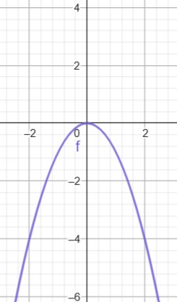
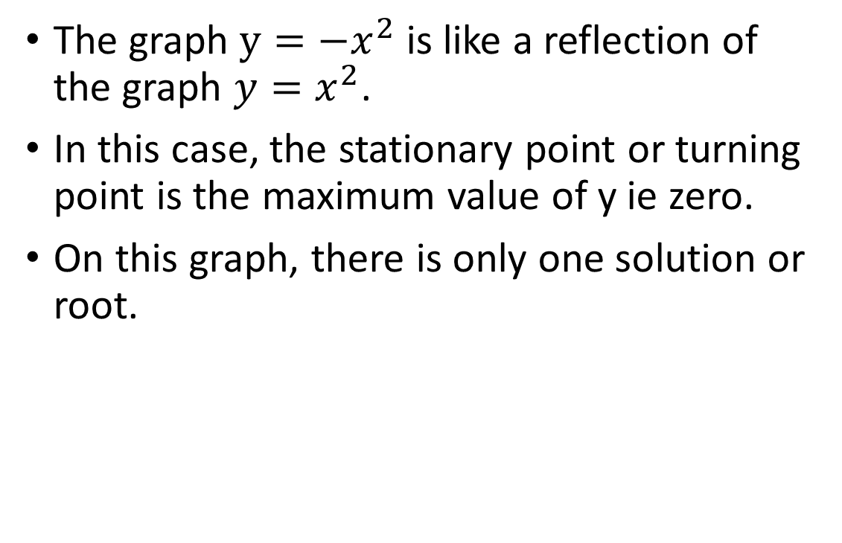
Quadratic Graphs
The graph $y=−x^{2}$ is like a reflection of the graph $y=x^{2}$.
In this case, the stationary point or turning point is the maximum value of y ie zero.
On this graph, there is only one solution or root.
Notes:
The graph, y= minus x squared is a mirror image of y= x squared. The x axis forms the mirror line.
In the graph, y= minus x squared, there is only one root or solution as the graph touches the x axis at only one point. The solution or root of this equation is x=0.
The turning point is also at (0,0).
As you are not adding or subtracting any number from the x squared, the intercept is at (0,0) as well.

Slide 11
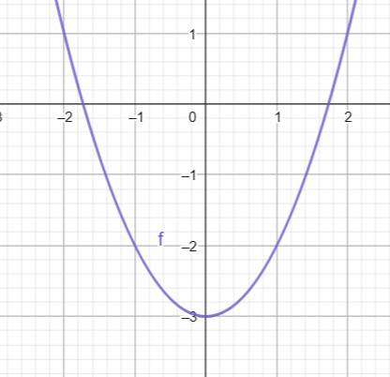
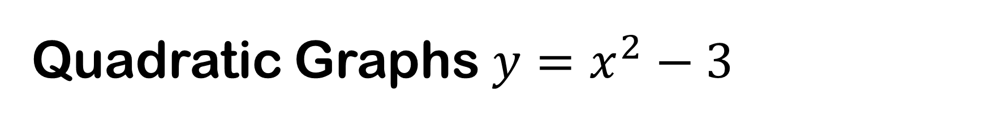
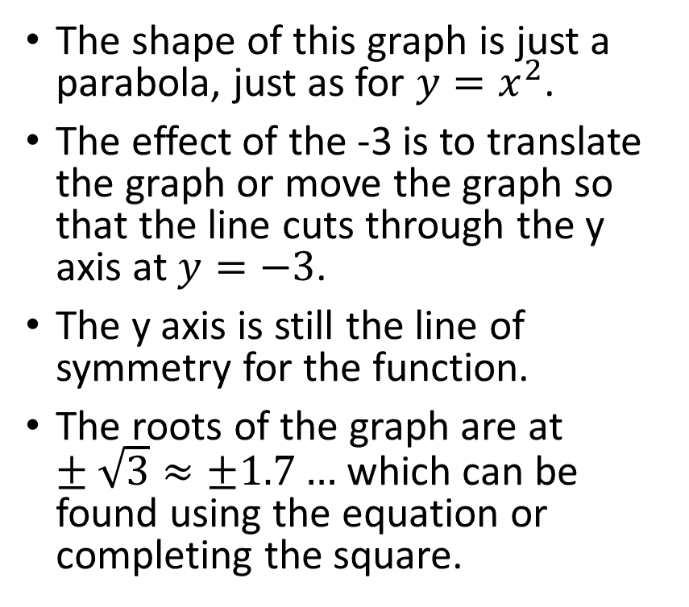
Quadratic Graphs $y=x^{2}−3$
The shape of this graph is just a parabola, just as for $y=x^{2}$.
The effect of the -3 is to translate the graph or move the graph so that the line cuts through the y axis at $y=−3$.
The y axis is still the line of symmetry for the function.
The roots of the graph are at $±\sqrt{3}≈±1.7…$ which can be found using the equation or completing the square.
Notes:
The effect of the -3 in the equation is to translate or move the graph down so that the graph line goes through the y axis at (0,-3)
Finding the roots or solutions of the graph can be done using the quadratic formula of $x=\frac{−b±\sqrt{b^{2}−4ac}}{2a}$ although an estimate can be gained by looking at the graph.
In this case, the roots where the line goes through the x axis are $±\sqrt{3}$ which is approximately 1.730205081 rounded to 9 decimal places, although root 3 is an irrational number and so has an infinite number of decimal places without repeating pattern occurring anywhere. Some of you will know that we call square roots that behave like this surds.
The important thing to note here is that the effect of the minus three in the equation is to move the graph down so that instead of running through (0,0), it runs though (0,-3).

Slide 12
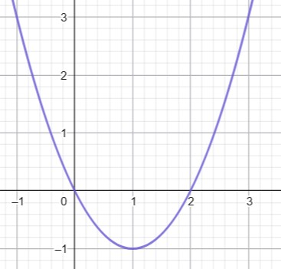
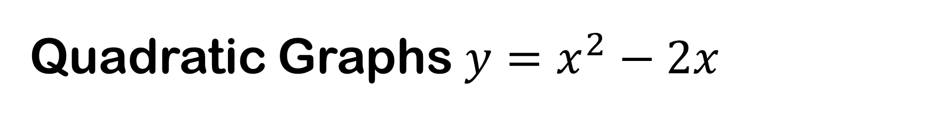

Quadratic Graphs $y=x^{2}−2x$
This graph retains the parabola shape from the $x^{2}$ part of the function.
The effect of the $−2x$ is to move the graph to the right, half the distance of the b co-efficient.
Notes:
Let’s examine what is going on with this graph.
The parabola shape is held by the x squared part of the graph in the function.
However, the -2x has the effect of translating the graph one unit to the right. The line of symmetry moves so that it becomes $x=\frac{−b}{2}$.

Slide 13
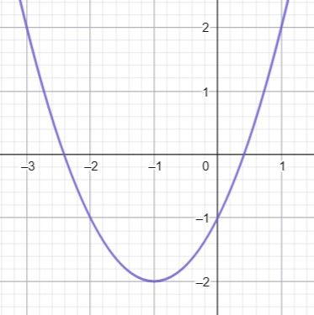
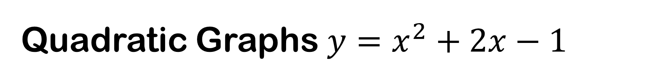
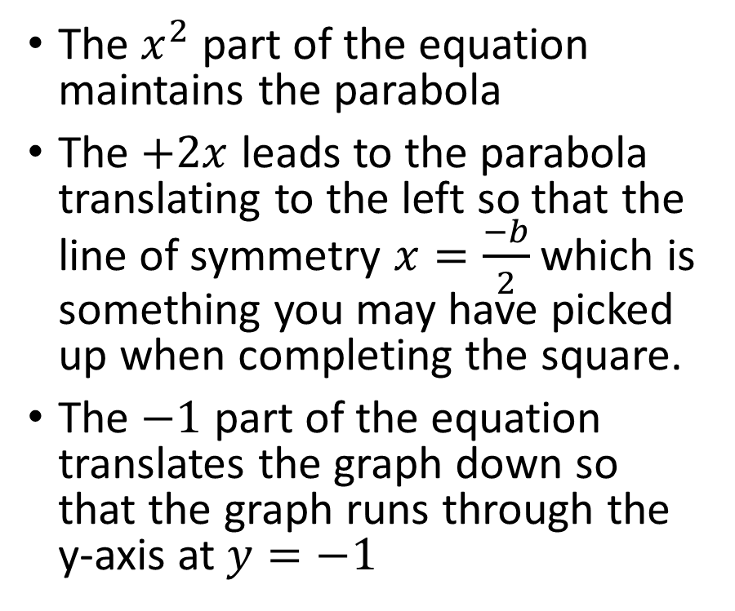
Quadratic Graphs $y=x^{2}+2x−1$
The $x^{2}$ part of the equation maintains the parabola
The $+2x$ leads to the parabola translating to the left so that the line of symmetry $x=\frac{−b}{2}$ which is something you may have picked up when completing the square.
The $−1$ part of the equation translates the graph down so that the graph runs through the y-axis at $y=−1$
Notes:
When considering the graph on this slide, you need to bear in mind the quadratic equation that we met on the slide titled quadratic equations. This, if you remember was $ax^{2}+bx+c=0$. A is the the x squared coefficient, B is the x-coefficient and c is the number tagged on the end.
This graph is affected in three ways. The shape of the graph is determined by the x squared section of the equation.
The plus two x is where 2 is the x co-efficient. When considering how this effects the position of the graph, it is useful to remembering completing the square. Plus 2 moves the graph’s line of symmetry one unit to the left. The thing to remember is that the line of symmetry is moved to make the equation for the line of symmetry $y=\frac{−b}{2}$.
The minus 1 part of the equation has the effect of moving the graph down so that the intercept where the graph meets the y axis is at (0,c)

Slide 14
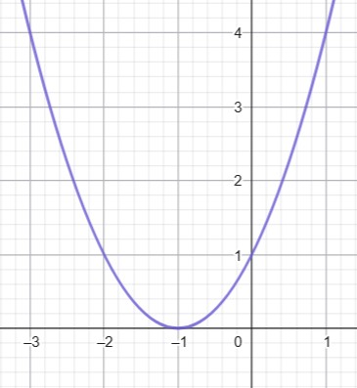
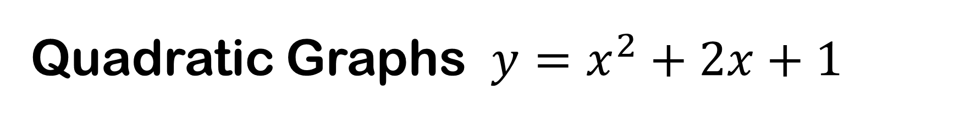
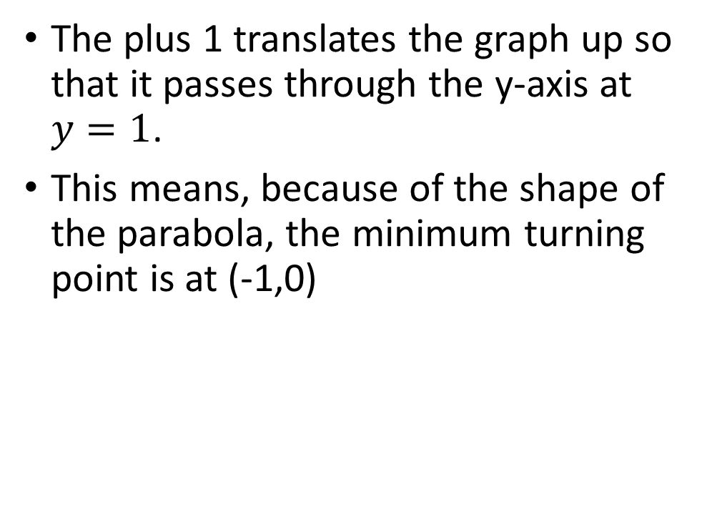
Quadratic Graphs $y=x^{2}+2x+1$
The plus 1 translates the graph up so that it passes through the y-axis at $y=1$.
This means, because of the shape of the parabola, the minimum turning point is at (-1,0)
Notes:
Here, we have the same equation as on the previous slide apart from instead of minus 1, we have plus 1.
This has, in effect moved the x squared graph one box to the left.
Maybe you would like to use geogebra to see if you can rest the quadratic parabola so that the minimum point rests on (-2,0), (-3,0) (-4,0) and then (1,0), (2,0) and so on.

Slide 15
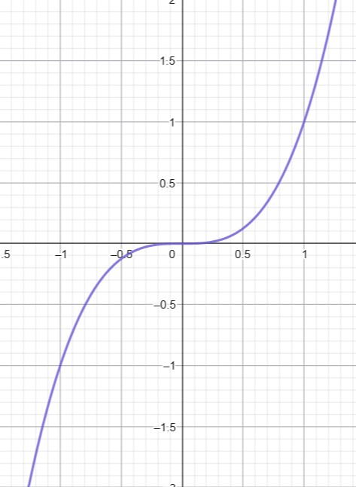

Cubic Graphs $y=x^{3}$
Cubic equations have the highest order of 3.
Runs through the origin
Like a backwards s shape
Runs through (-1,-1) and (1, 1)
Shaped like half a parabola and half a parabola upside down
Notes:
Polynomial equations have either an odd number or an even number as the highest order.
If they have an odd number, they are shaped like a backwards s.
We shall examine this in more detail on the next slide.
In terms of this particular graph, it is a graph of y=x cubed which means x times x times x. Whenever there are an odd number of x’s in the equation, a negative x will lead to a negative y.
If there are an even number of x’s in the equation (such as with x squared) then a negative x times a negative x leads to a positive y which results in the U shape of the quadratic and other even ordered graphs.

Slide 16
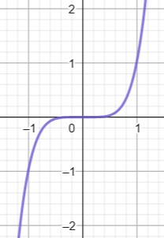


Higher orders of odd numbered indices
$$y=x^{3}$$
$$y=x^{5}$$
Notes:
In these graphs, you should be able to spot the differences in the shape. The middle horizontal section is more pronounced in the x^5 version of the graph than the x cubed version. It is flatter and longer and when it does turn up, the sides of the graph are steeper.
Note that both graphs go through (-1,-1) and (1,1) though.

Slide 17
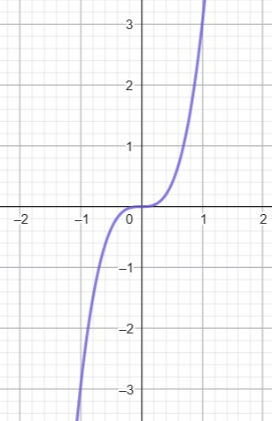

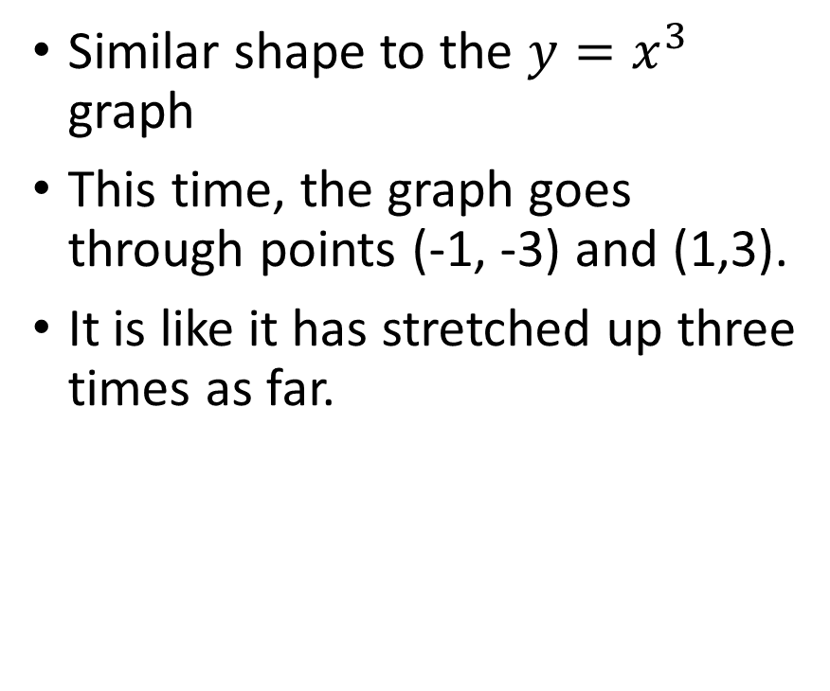
Cubic Graphs $y=3x^{3}$
Similar shape to the $y=x^{3}$ graph
This time, the graph goes through points (-1, -3) and (1,3).
It is like it has stretched up three times as far.
Notes:
The graph of y=3 x cubed is similar in shape to the graph of y=x cubed apart from this time, the graph does not run through (-1,-1) and (1,1). Instead, it runs through (-1,-3) and (1, 3) which makes sense because the graph has been stretched up so it is 3 times as high. If you think about it, when x is 1, x cubed is one and if you times that by 3, then you get 3. The same is true for – x cubed When you multiply it by 3, you end up with y being -3. So the x cubed co-efficient has the effect of elongating the graph up and down by that number of times. This is going to be the same for all graphs.

Slide 18
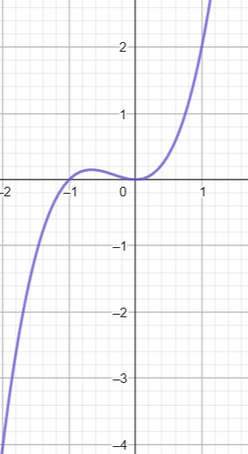

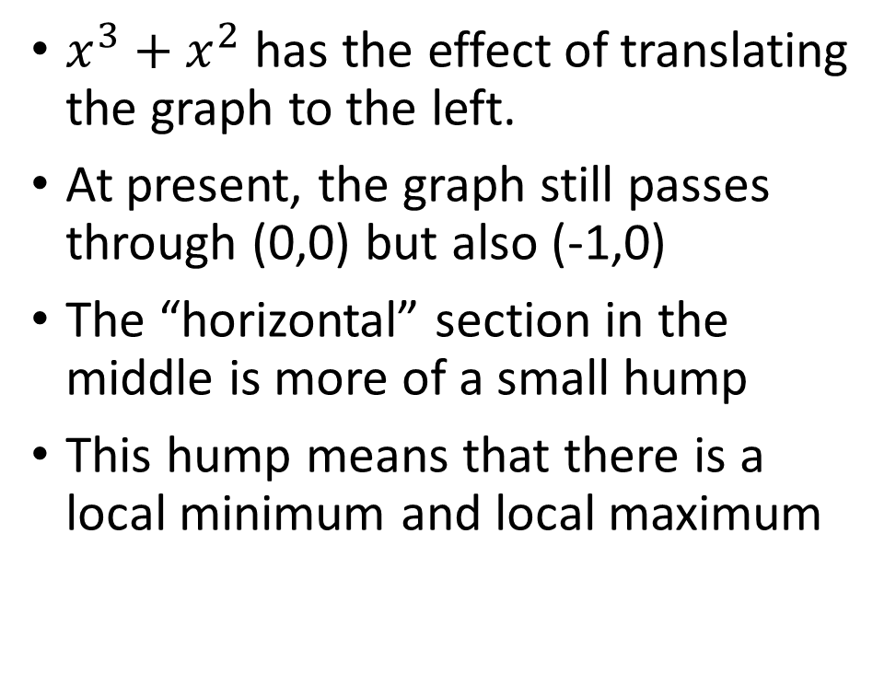
Cubic Graphs $y=x^{3}+x^{2}$
$x^{3}+x^{2}$ has the effect of translating the graph to the left.
At present, the graph still passes through (0,0) but also (-1,0)
The “horizontal” section in the middle is more of a small hump
This hump means that there is a local minimum and local maximum
Notes:
Adding x squared to the graph of x cubed changes its appearance in subtle ways.
Firstly, the flatness of the central section is replaced by a hump. Secondly, the whole graph is moved to the left slightly and now runs through the points (-2,-4), (0,0) and (1,2).
Adding x squared translates the graph to the left whereas subtracting it would translate it to the right.

Slide 19
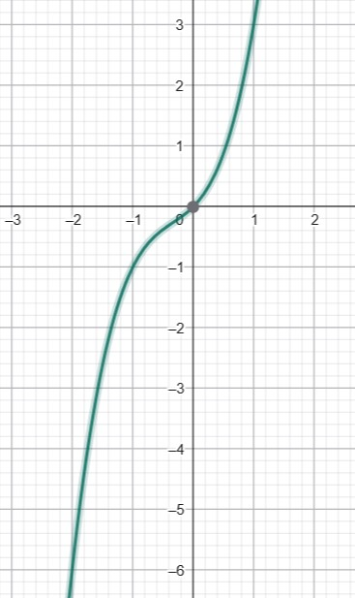

Cubic Graphs ${y=x}^{3}+x^{2}+x$
This time, if we add x, it has the effect of making the graph appear to fall away more steeply from the origin
Points of interest on this graph are (-1,-1), (0,0) and (1,3)
Notes:
Here, the graph falls away from the origin more steeply.
Now, compare this to the graph on the next slide which indicates minus x instead of plus x.

Slide 20
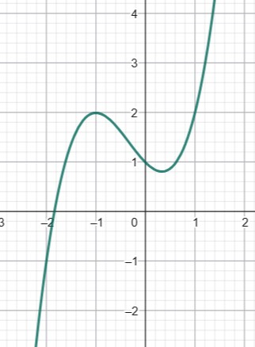

Cubic Graphs $y=x^{3}+x^{2}−x+1$
The effect of the add 1 just moves the graph up
Changing +x to –x has a significant effect on the shape of the graph
Points to note include the local maximum at (-1,2)
Notes:
Putting a minus x instead of a plus x has a significant effect on the shape of the graph making what was the horizontal central section into a much more pronounced hump.

Slide 21
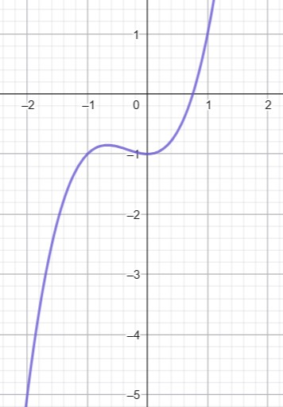

Cubic Graphs $y=x^{3}+x^{2}−1$
Subtracting 1 just translates the graph downwards.
Adding 1 would translate the graph upwards.
Notes:
Subtracting or adding a number to any graph just has the effect of manoeuvring the graph so that the intercept is equal the constant term which you have added or subtracted. In this case, the intercept where the graph crosses the y axis is at -1.

Slide 22
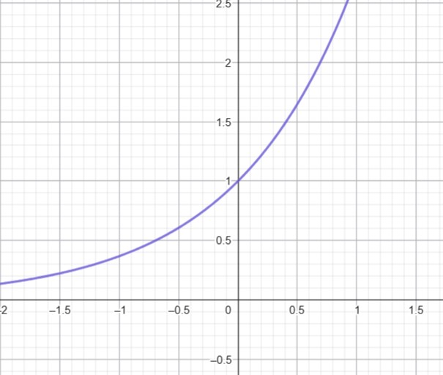

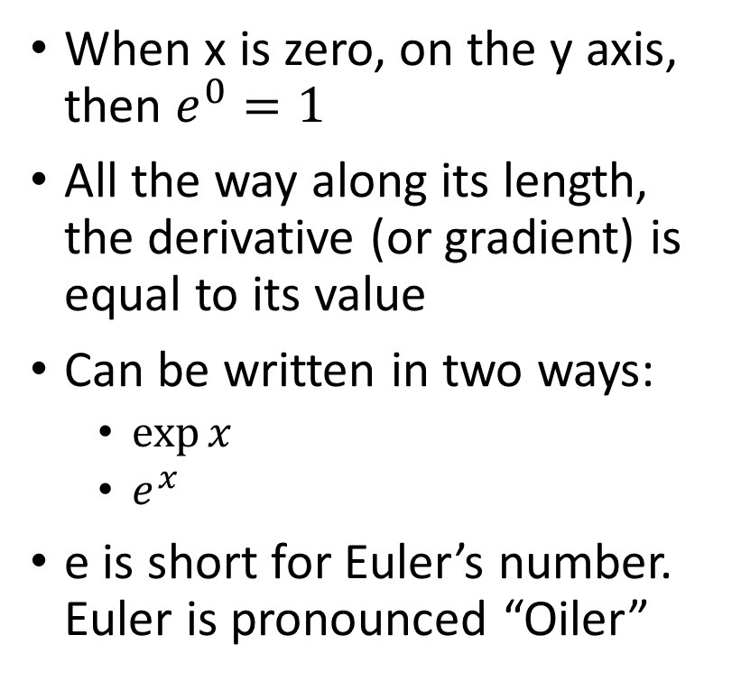
Exponential function ${y=e}^{x}$
When x is zero, on the y axis, then $e^{0}=1$
All the way along its length, the derivative (or gradient) is equal to its value
Can be written in two ways:
$\exp{x}$
$e^{x}$
e is short for Euler’s number. Euler is pronounced “Oiler”
Notes:
The exponential function is really great as it has lots of amazing things it can do. The number, e, sometimes called OILer’s number is the base. This number is more or less 2.71828 and this is the base of natural logarithms. These allow us to do all kinds of calculations.
One of the amazing things about this graph is that its derivative or gradient is as $e^{x}$ all the way along its length. This means that the gradient of the tangent at any point is equal to the value of the y co-ordinate at that point.
There is a Power Series that allows the calculation of the exponential function. $e^{x}=1+x+\frac{x^{2}}{2!}+\frac{x^{3}}{3!}+\frac{x^{4}}{4!}+…= \sum_{n=0}^{∞}{\frac{x^{n}}{n!}}$
There is no where in with the Real numbers that the exponential function hits zero. It does get painfully close though as you look at back at higher negative values. This property of not touching the line is an asymptotic value.

Slide 23
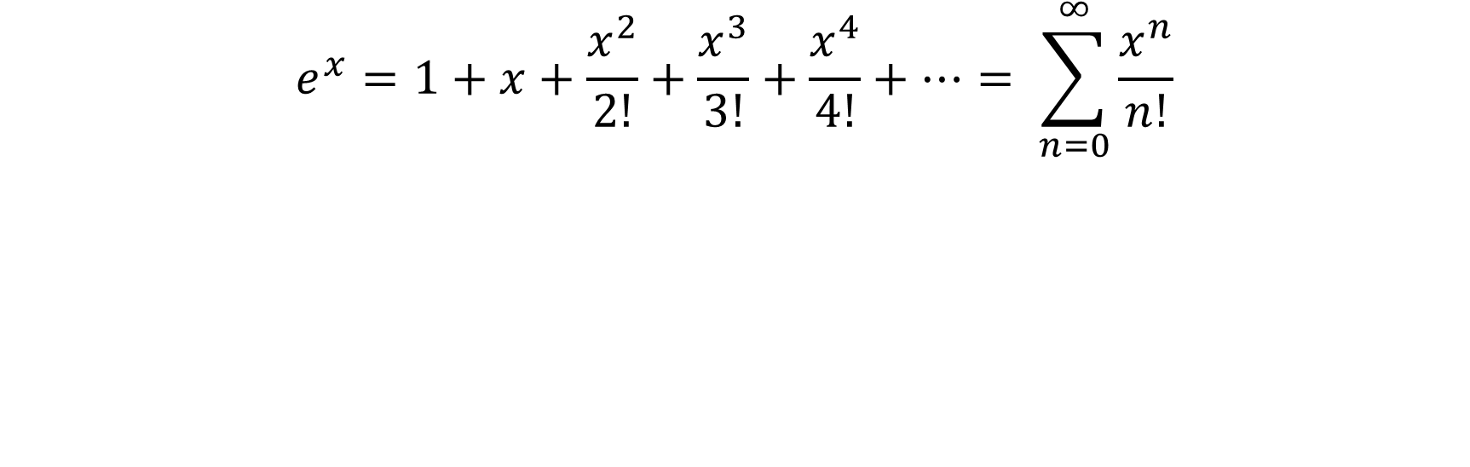
Power Series of the exponential function
$$e^{x}=1+x+\frac{x^{2}}{2!}+\frac{x^{3}}{3!}+\frac{x^{4}}{4!}+…= \sum_{n=0}^{∞}{\frac{x^{n}}{n!}}$$
Notes:
You can use this formula to work out the value of the exponential function at any point.

Slide 24
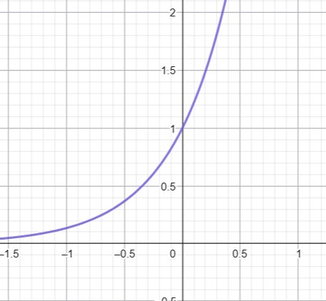

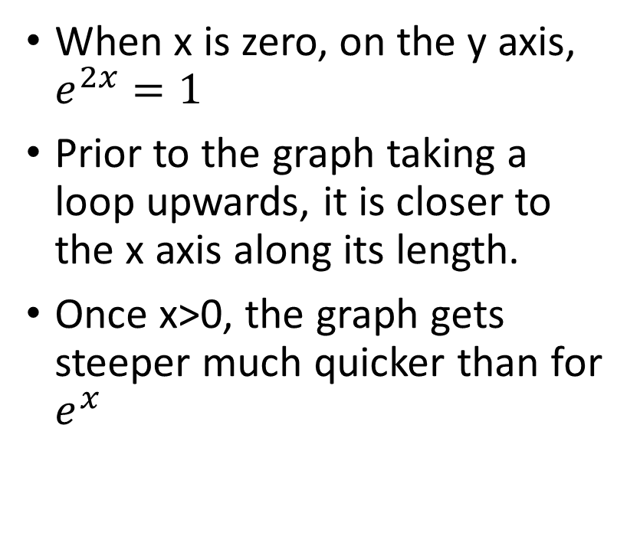
Exponential Function $y=e^{2x}$
When x is zero, on the y axis, $e^{2x}=1$
Prior to the graph taking a loop upwards, it is closer to the x axis along its length.
Once x>0, the graph gets steeper much quicker than for $e^{x}$
Notes:
Comparing the graph of e to the power of 2x to that of e to the power of x, this function is quicker to move to its asymptotes than the e to the x version.
If you were asked to work out the product of e to the power of 2x and 5, a quick method of doing this would be to look where x=0. 2 to the power of zero would be 1 and then multiplying this by 5 will mean that the graph will go through (0,5)

Slide 25
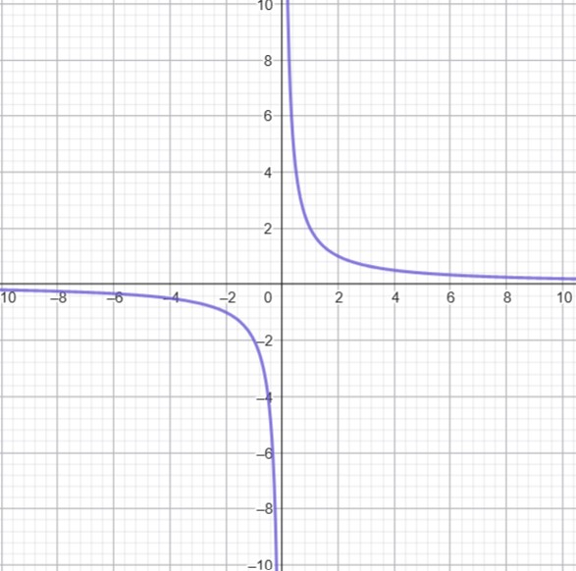

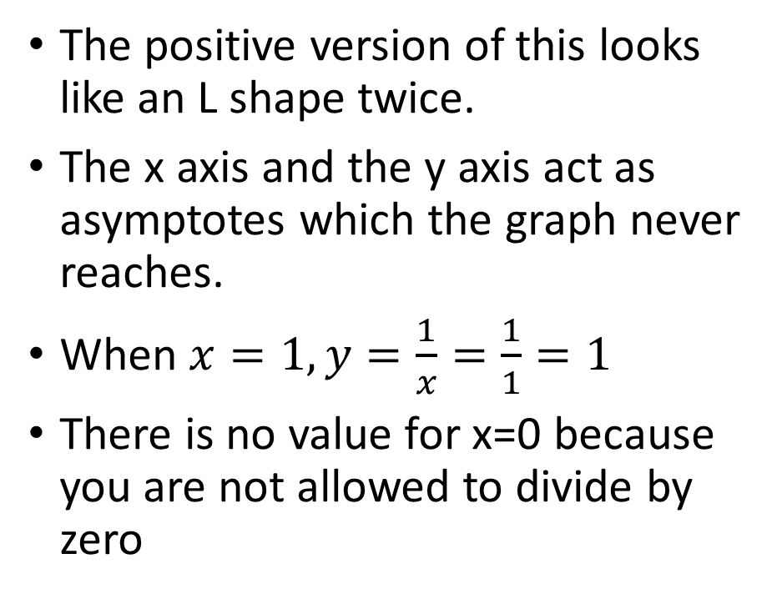
Reciprocal Graphs $y=\frac{1}{x}$
The positive version of this looks like an L shape twice.
The x axis and the y axis act as asymptotes which the graph never reaches.
When $x=1, y=\frac{1}{x}=\frac{1}{1}=1$
There is no value for x=0 because you are not allowed to divide by zero
Notes:
Reciprocal graphs form a couple of L shapes. Both axes act as asymptotes which means the graph never actually crosses them. This can be deduced from the fact that the graph is formed from the equation 1 over x and you are not allowed to divide by zero.
For the graph $y=\frac{1}{X}$, the domain is very much in the quadrants in the lower left and upper right quadrants.

Slide 26
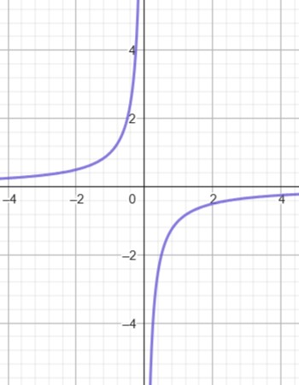


Reciprocal Graphs $y=−\frac{1}{x}$
The quadrants where the graph resides are opposite to the ones for $y=\frac{1}{x}$
Notes:
The graph resides in the opposite quadrants to y=1 over x.

Slide 27
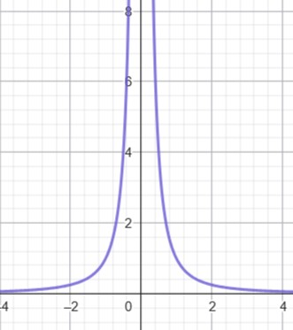

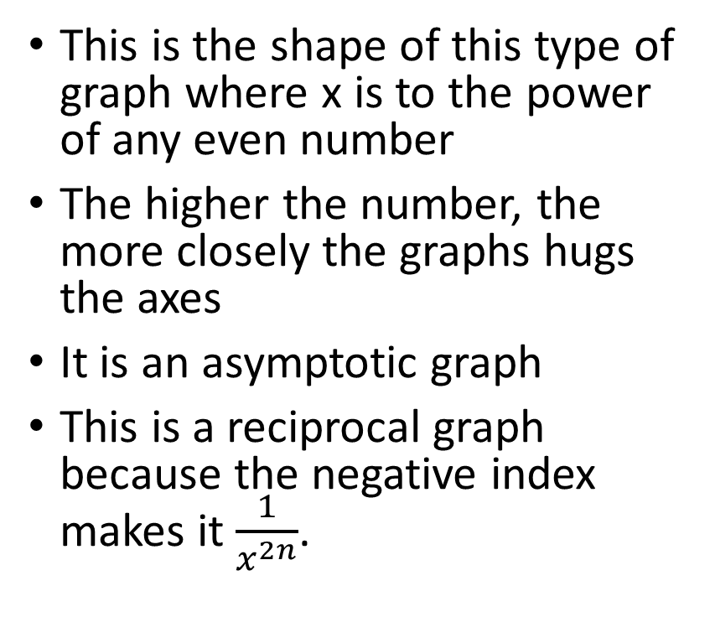
Reciprocal Graphs $y=x^{−2n}$
This is the shape of this type of graph where x is to the power of any even number
The higher the number, the more closely the graphs hugs the axes
It is an asymptotic graph
This is a reciprocal graph because the negative index makes it $\frac{1}{x^{2n}}$.
Notes:
The graph of y=x to the power of minus two is shown here. Again, this is an asymptotic graph where the graph line never actually goes where zero is.
The shape of the graph is almost always the same for negative even numbers although it tends to hug the axes more and more with each increase in the absolute power.
Remember that negative power changes the function to being a reciprocal one.

Slide 28
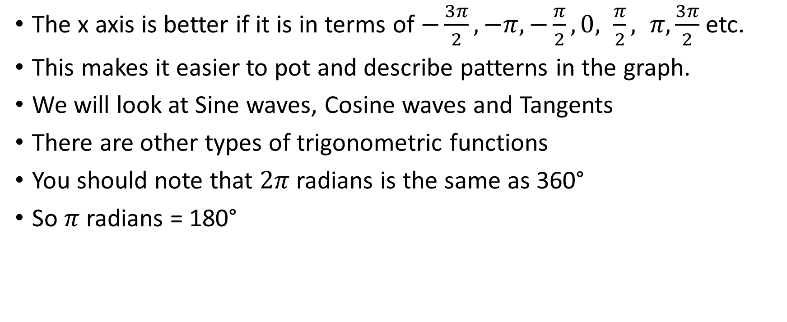
Trigonometric Graphs
The x axis is better if it is in terms of $−\frac{3π}{2}, −π,−\frac{π}{2},0, \frac{π}{2}, π, \frac{3π}{2}$ etc.
This makes it easier to pot and describe patterns in the graph.
We will look at Sine waves, Cosine waves and Tangents
There are other types of trigonometric functions
You should note that $2π$ radians is the same as 360°
So $π$ radians = 180°
Notes:
Trigonometric functions are different to other types of graph in that we prefer to label the x axis in terms of PI.
This is because the points of interest, for instance, where the graph lines cross the x axis or reach a peak tend to be in line with PI or PI over 2 etc.

Slide 29



Sine Waves $y=sin⁡(x)$
$y=\sin\left(x\right)$ is a wave that undulates from 1 to -1
The wavelength is $2π$ long which means that the sine wave goes through the x axis at multiples of $π$.
Something that you need to note is that the sine wave goes through (0,0).
Notes:
Y = sine(x) is a wave shaped graph that undulates from a peak to peak measure of 1 to minus 1 repeatedly.
The peaks fall at x-coordinates of PI over 2, 3Pi over 2, 5Pi over 2 etc.
The wave length is 2 PI long but you need to note that Sin(x) crosses the x axis at multiples of PI.
The way to differentiate a sine wave from a cosine wave is that the sine wave passes through (0,0).

Slide 30



Cosine Waves $y=cos⁡(x)$
$y=\cos\left(x\right)$ is a wave that undulates from 1 to -1
The wavelength is $2π$ long which means that the cosine wave goes through the x axis at odd multiples of $\frac{π}{2}$ and hits the peaks at multiples of $π$.
Something to note is that the cosine wave goes through (0,1) which is different to a sine wave.
Notes:
Y = cos(x) is a wave shaped graph that undulates from a peak to peak measure of 1 to minus 1 repeatedly.
The peaks fall at x-coordinates that are multiples of PI.
The wave length is 2 PI long but you need to note that Sin(x) crosses the x axis at multiples of odd numbers of Pi over 2, for instance, 3Pi over 2, 5Pi over 2 etc.
The way to differentiate a cosine wave from a sine wave is that the cosine wave passes through (0,1).

Slide 31



Sine wave transformations $y=sin⁡(2x)$
$y=sin⁡(2x)$
Note that the peak to peak remains going from 1 to 1
However, the wavelength changes from $\sin\left(x\right)$ which is $2π$ to $sin⁡(2x)$ which is $π$ so the waves seem squashed up.
Notes:
The difference between sine 2x and sine x is that the wavelength halves but the peak to peak distance stays the same.

Slide 32


Sine wave transformations
$y=sin⁡(2x)$
$y=2sin⁡(x)$
Notes:
As discussed on the previous slide, the graph for y = sin(2x) is different to the graph for y=2sin (x).
The latter of these just means double the size of the graph of sin(x) so the peak to peak value is now -2 to 2 instead of the -1 to 1 but the wavelength stays the same as in sine x.

Slide 33


Comparing the Sine and Cosine Waves
Grey is the Cosine Wave which “leads” the Green Sine Wave by $\frac{π}{2}$ wavelengths
Sine goes through (0,0): Cosine goes through (0,1)
Notes:
This pair of graphs compare the cosine with the sine wave. Cos(x) has the same wave shape and wavelength as Sin(x). The only difference is that Cos(x) appears to lead the Sin(x) wave by PI over 2. This pattern continues all the way along the length of the two waves.

Slide 34


Comparing Sine and Cosine Waves
$Sin\left(x\right)$ is the green line.
$Cos(x+\frac{π}{2})$ is the grey line.
So these two graphs are mirror images of each other with the x-axis acting as the mirror line.
Notes:
Drawing different trigonometric graphs on the same axis can have interesting effects. Here, we have the x axis acting as a mirror line for Sin(x) and Cos(x+ PI over 2).

Slide 35

Trigonometric Tangents
Tangent graphs are unusual.
They have asymptotes where the graph approaches a particular value but never actually gets there (usually because of division by zero which is not allowed).
Notes:
This unusual graph is a graph of tan(x). Asymptotes appear between the curves shown and although these curves go on forever, they never actually meet to form a continuous function. Consequently, there are values for which the function Tan(x) is not valid. These are where Cos(x) =0 and include 90 degrees, or PI over 2 radians, 270 degrees or THREE PI over 2 radians and repeat every PI or 180 degrees in both directions forever.

